Slide 1
Toronto Restaurant Analysis
By: Monica Smith

Slide 2
Introduction
I would like to help recommend a location in Toronto to open a restaurant. I will leverage Foursquare data on popular restaurants in Toronto in order to visualize the competition. I will also incorporate data on population per square kilometre and average income to help the restaurant owner make the decision.

Slide 3
Data
Foursquare → Popular Toronto restaurants in each neighbourhood
Statistics Canada → Population density and average income

Slide 4
Methodology & Results
Population Density vs average income
Most popular restaurants in Toronto
Neighbourhood cluster analysis

Slide 5
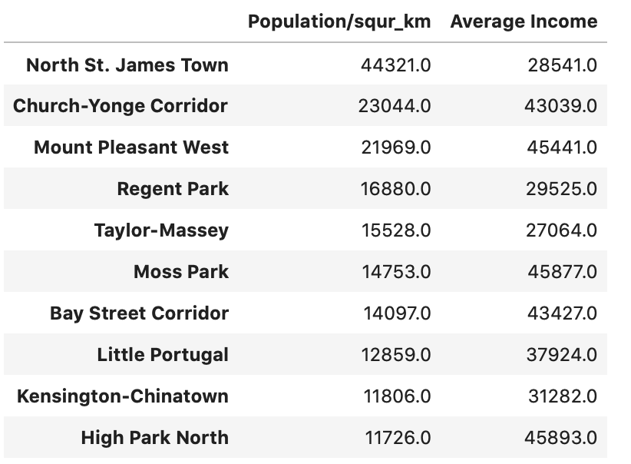
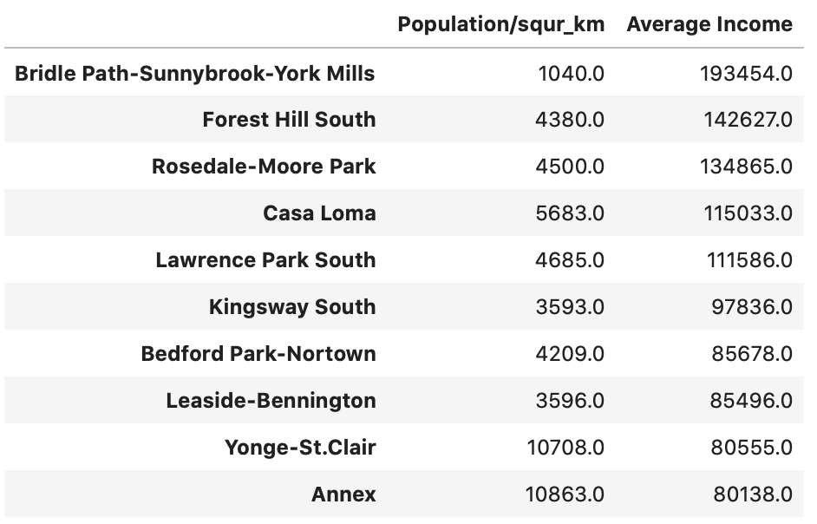
Population Density vs Average Income
Highest Population Density
Highest Average Income

Slide 6
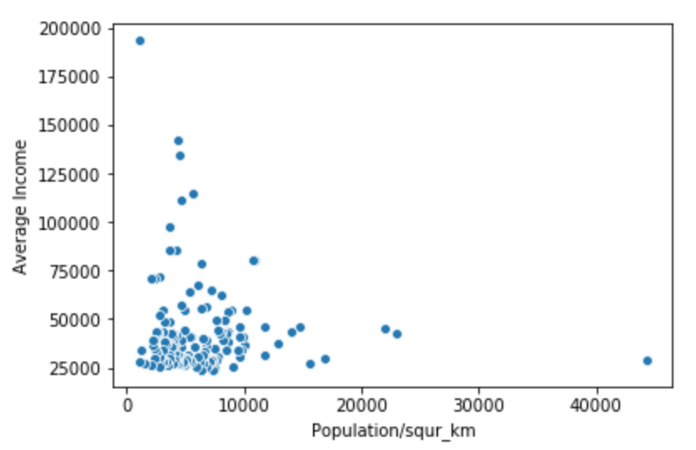
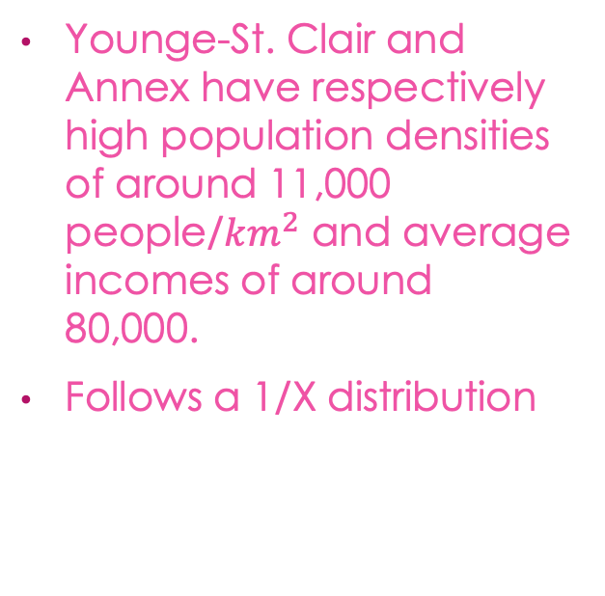
Results
Younge-St. Clair and Annex have respectively high population densities of around 11,000 people/$km^{2}$ and average incomes of around 80,000.
Follows a 1/X distribution

Slide 7
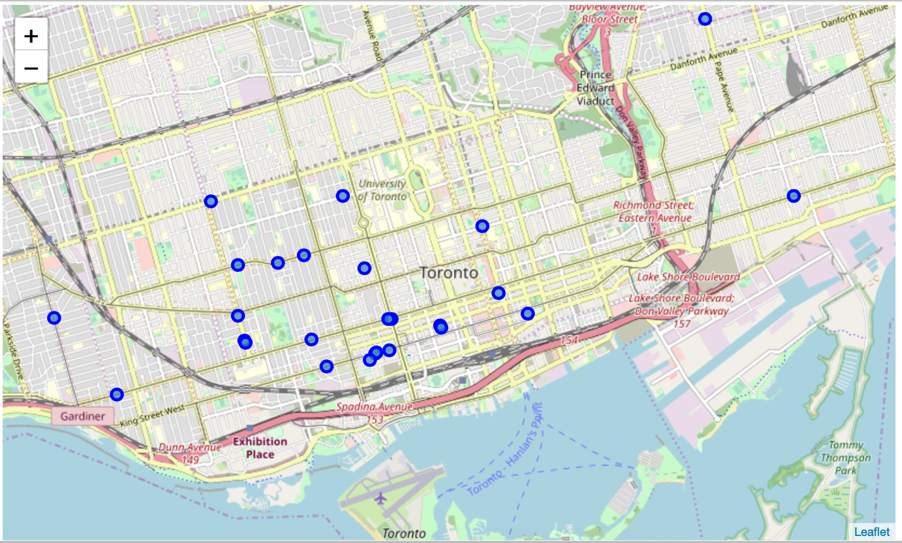
Most Popular Restaurants in Toronto
Top 50 most popular restaurants in Toronto
Important not to open restaurant very close to competition
Multiple hot spots in downtown core

Slide 8
Neighbourhood Cluster Analysis
Cluster analysis based on the types of existing restaurants and their location
Leveraged top 100 restaurants in each Borough
Method of one hot encoding used to transform data
Machine learning method of kmeans was used to segment each of the restaurants into one of the 5 clusters

Slide 9
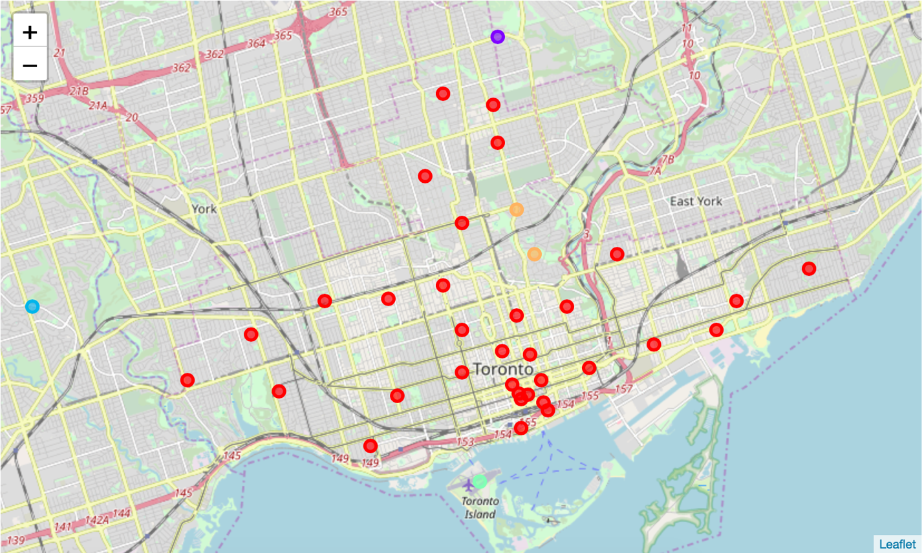
Results
Majority of Neighbourhoods fall within the red cluster
Red cluster is mostly cafés, pizza and American food
Other 4 clusters seem to favour foreign food types more
In central Toronto locations there is a preference for national foods

Slide 10


Thank You

